Slide 1
Building a Data Mesh Architecture in Azure
Data Mesh vs Azure (Theory vs Practice)

Slide 2
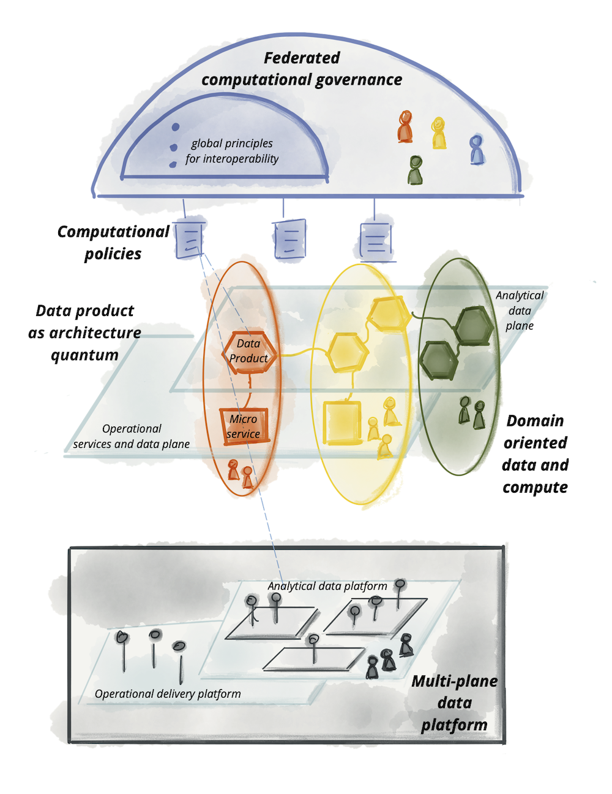
Data Mesh vs Azure – Part 1
Theory vs Practice
Image Source: https://martinfowler.com/articles/data-mesh-principles.html

Slide 3
Data Mesh vs Azure – Part 2
Theory vs Practice

Slide 4
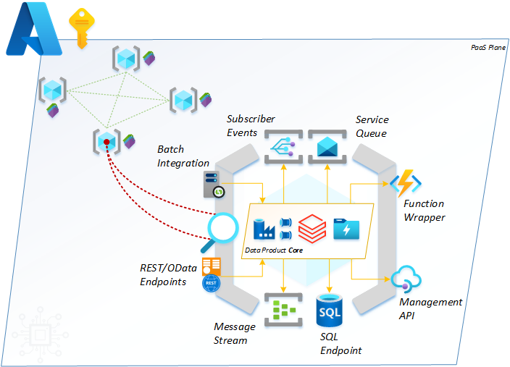
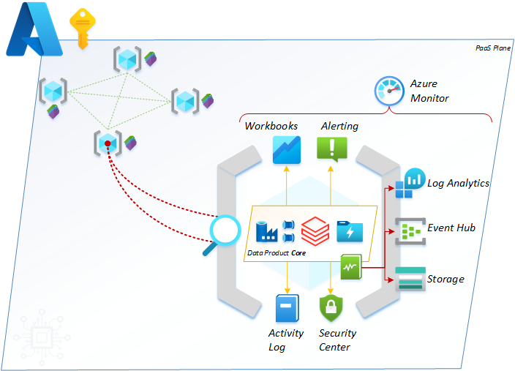
Data Mesh vs Azure – Part 3
Theory vs Practice
Secondary Interfaces - operational reporting and logging.
Primary Interfaces – data integration and exchange.
Tertiary Interfaces - resource connectivity.

Slide 5

Data Mesh vs Azure – Part 4
Theory vs Practice
Blog contributions and wisdom from
Mr Rob Sewell (@sqldbawithbeard).

Slide 6
Data Mesh vs Azure – Part 5
Theory vs Practice
Data Mesh – Domains vs Products
A hierarchy of scale:

Slide 7
Data Mesh vs Azure – Part 6
Theory vs Practice

Slide 8
Data Mesh vs Azure – Part 7
Theory vs Practice
A Mesh Marketplace
A Self-Service Analytics Canvas
An Onboarding Framework

Slide 9
Data Mesh vs Azure
Defining a Data Product
Data Domain (Business) Drivers
Data Requirements
Technical Capabilities

Slide 10
Data Mesh vs Azure
Defining a Data Product
Domain Driven
Data Required
Technically Capable
Revenue Generating
Supplementary
Governance Aligned
Accurate
Meaningful
Necessary
Accessible
Connected
Modelled
Timely
Deployable

Slide 11
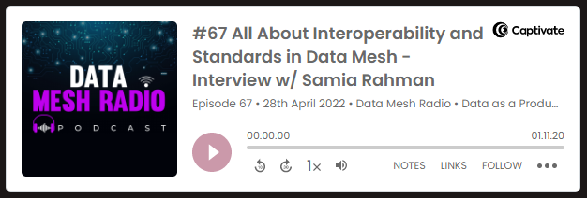

Data Mesh vs Azure
Data Mesh Radio Podcast
#68 A Minimum Viable Data Mesh?
https://daappod.com/data-mesh-radio/

